Slide 1
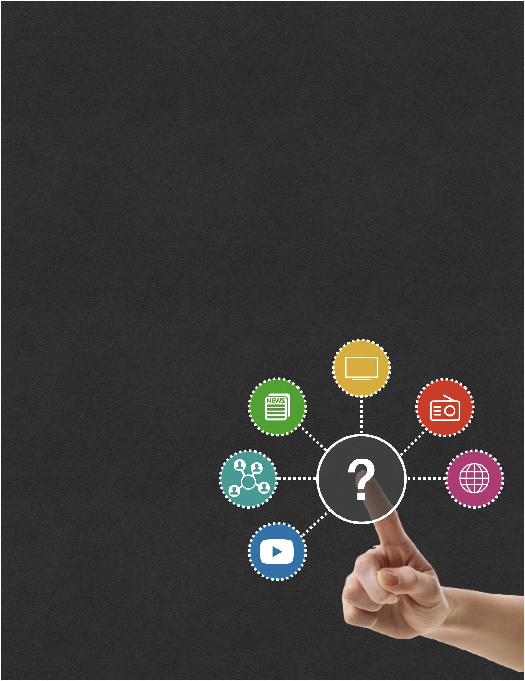
Online training: Developing Your Information Literacy
Participant Booklet

Slide 2

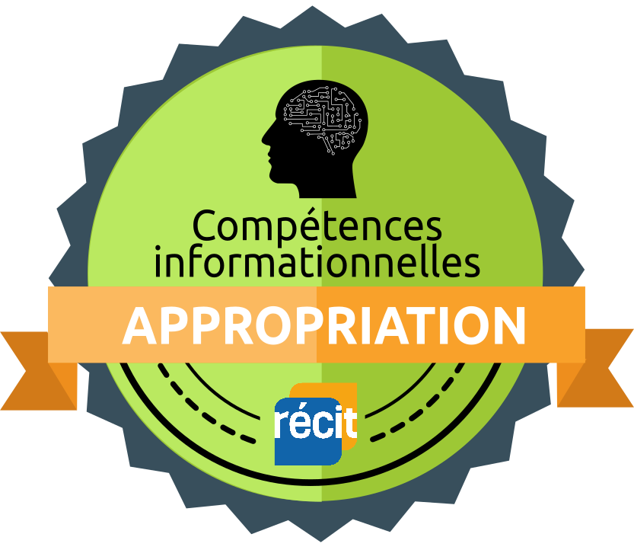

Online training: Developing Your Information Literacy
Participant Booklet
Badge opportunities
“Discover” Badge
The “Discover” Badge is awarded to the learner that explores a new topic, a new technology and discovers the learning object of this training.
To earn this badge, you must successfully answer the quiz in module 2.
“Apply” Badge
The “Apply” badge is awarded to the learner who implements the learning object or a suggested tool.
To earn this badge, you must share a reflection on your use of one of the digital tools
suggested in Module 3.
“Contribute” Badge
The “Contribute” badge is awarded to the learner who shares with the community an activity or a learning situation, a reflection about a digital tool or the learning object of this course.
To earn this badge, you must share your media collection with other educators in
Module 5.

Slide 3
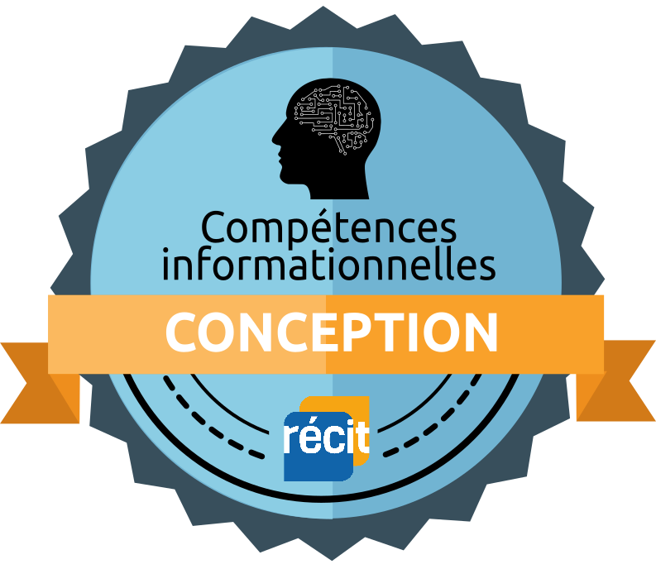
Online training: Developing Your Information Literacy
Participant Booklet
You have the opportunity to earn the two badges below at any moment during your training. Once you have completed the tasks, share the results as a homework in the badge section of the course.
“Design” Badge
The “Design” Badge is awarded to the learner who creates a digital learning activity to reinvest an element of information literacy learned in this course that could be used in class.
Throughout the modules, you will discover digital tools that can inspire you. At any time,
when you feel like reinvesting your new knowledge about information literacy, create a
digital activity, go into the Badge module or learning sequence and share it in a homework.
“Transfer” Badge
The “Transfer” Badge is awarded to the learner who experiments with students a learning sequence or activity that integrates the learning object and technology with a pedagogical intention.
To earn this badge, you must share, for example, a student production, a photo or a video of the activity that was experimented in class. You could reinvest the learning sequence or activity created for the Design Badge or create another.
Some of you may not have access to a class. In this case, you can try to reproduce a similar context (in a training for example) or ask a colleague to experiment in their class.

Slide 4
Online training: Developing Your Information Literacy
Participant Booklet
Module 1
Context

Slide 5

Module 1
Overview of the Inquiry Process and Information Literacy
Context
Personal Notes

Slide 6
Online training: Developing Your Information Literacy
Participant Booklet
Module 2
Overview of the Inquiry Process

Slide 7
Module 2
Overview of the Inquiry Process
Develop and mobilize your information literacy competencies
Activity 2.3 - Answer the survey
You can earn a “Discover” badge if you can identify the learning goal of this training.
To receive this badge, you must pass the quiz.
Notes:
https://view.genial.ly/5fb3e4c2b087e01477f310a4/horizontal-infographic-review-recherche-et-traitement-de-linformation

Slide 8
Online training: Developing Your Information Literacy
Participant Booklet
Module 3
Plan your research

Slide 9

Module 3
Plan your research
Creating a Work Plan
Activity 3.2.1 Planning your research project
What is the purpose or intention of your research? (Is it to entertain, inform, incite, convince, etc.?)
What is your research topic?
Who is your target audience?
What resources are available to you (people, materials, time)?
What steps are involved in your research project (timeline)?
What type of production are you creating? Describe it.

Slide 10

Module 3
Define Your Information Needs
Activity 3.4.1 Exploring Digital Tools to Activate Prior Knowledge
Your theme is now chosen and it is time to activate your prior knowledge. Votre thème est maintenant choisi.
Which tool(s) have you explored? What are their advantages? What are their limits?

Slide 11
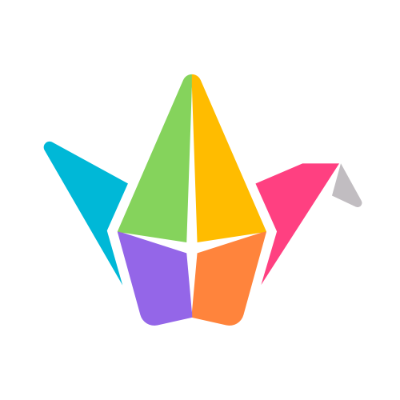
Module 3
Define Your Information Needs
Activity 3.4.2 Creating Your First Digital Pedagogical Activity
Task
With a tool of your choice, create a short activity that will activate your student’s prior knowledge.
Add the link to your activity in your participant booklet.
Share! (optional)
Share your ideas with other teachers in this collaborative Padlet. You could also get inspired by the ideas of others.

Slide 12

Module 3
Define Your Information Needs
Determining the Main and Secondary Questions
Activity 3.6.1 Main and secondary questions, subtopics and exploring your topic.
It's now time to formulate your main inquiry question as well as your secondary questions. Look at the information you wrote down in your brainstorm to guide you. Don't forget to formulate a question that can't easily be answered in one or two sentences to make it more relevant.
Tip
You may not be very familiar with your research topics. In such cases, you may want to watch a short video, read a blog post, look at an image or consult an article in an encyclopedia to figure out what aspects of the topic to focus on to determine your main and secondary questions.
Notes:
https://view.genial.ly/5fb3e4c2b087e01477f310a4/horizontal-infographic-review-recherche-et-traitement-de-linformation

Slide 13

Module 3
Plan your research
Keywords
Activity 3.8.1 Creating a list of keywords
Create a list of keywords based on your research question and secondary questions in your participant booklet or using a digital tool of you choice.

Slide 14
Module 3
Plan your research
Keywords
Activity 3.8.2 Expanding Your List of Keywords
We invite you to use tools to expand your list of keywords. These can be recorded in your participant booklet or using the digital tool of your choice.

Slide 15
Module 3
Plan your research
TO SUM UP
Activity 3.9.1
We invite your to record your thoughts, the key points of this module and/or a summary of what you have learned.
You can consult the “Curriculum Connections” page on the Digital Competency in Action website at any time to see how this step in the Inquiry Process connects with cross-curricular and subject-specific competencies at your students’ grade level. You can then use this information to help you plan how you will address these concepts with your students.
You can also take the time to look at the class resources we recommend and select those that are appropriate for your students’ grade level.
Notes:
https://view.genial.ly/5fb3e4c2b087e01477f310a4/horizontal-infographic-review-recherche-et-traitement-de-linformation

Slide 16
Online training: Developing Your Information Literacy
Participant Booklet
Module 4
Searching information

Slide 17

Module 4
Searching information
Where to Look for Information?
Activité 4.3.1 - Explore different sites you can search for information.
It is your turn to explore! You have just discovered a multitude of sites you can search. Some of these sites are well known, while others are less so. We invite you to explore them all. Who knows, you may find some new favourites!
Write down (you can also bookmark or create a digital board) your discoveries in your participant booklet so you can refer to them later.

Slide 18
Module 4
Searching information
Where to Look for Information?
ActivitY 4.7 - Hands-on Digital Activity
Now that you are familiar with how to do research, it is time to focus on the research topic you chose.
Using the keywords you selected in module 3, create various search queries using the different options presented to you in this module including Boolean operators, search modes, advanced search parameters, etc.
Copy and paste the resources you have found in your participant booklet. You will need them in the next module.

Slide 19
Module 4
Searching information
TO SUM UP
Activité 4.8
In your participant booklet, record your thoughts, the key points of this module and/or a summary of what you have learned.
You can consult the “Curriculum Connections” page on the Digital Competency in Action website to see how this step in the Inquiry Process connects with cross-curricular and subject-specific competencies at your students’ grade level. You can then use this information to help you plan how you will address these concepts with your students.
You can also take the time to look at the class resources we recommend and select those that are appropriate for your students’ grade level.

Slide 20
Online training: Developing Your Information Literacy
Participant Booklet
Module 5
Evaluate information

Slide 21
Module 5
Evaluate information
Activity 5.4 Evaluating the Reliability of Sources
Step 1
Take a look at two of the suggested sites.
For each site, note in your participant booklet the criteria you would use to determine whether the site contains reliable information.
Source 1 - Source 2 - Source 3

Slide 22
Module 5
Evaluate information
Activity 5.4 - Evaluating the Reliability of Sources
Step 2
Now take a look at the criteria we suggest you use to evaluate a source.
Based on this information, review the criteria you identified in the first activity and complete the evaluation grid for each of the three sites.
Following your evaluation of these three sources, how would you rate your habits with respect to selecting reliable sources?
Notes:
https://view.genial.ly/5fb3e4c2b087e01477f310a4/horizontal-infographic-review-recherche-et-traitement-de-linformation

Slide 23
Module 5
Evaluate information
Activity 5.5 Evaluate your sources
We invite you to use evaluation criteria to evaluate the sources you found in Module 4.

Slide 24


Module 5
Evaluate information
Sources
Activity 5.6 Create a collection of resources
It is easy to get lost when searching for information about a particular topic. The sheer amount of content available and the speed at which it is accessible can make it a nightmare to sort through and organize what you find.
This is why we suggest you create a “collection” using the Wakelet tool in order to save and organize your media resources. You can also share them with your students, which will facilitate their search for information.
Tutorial
Share your collection on our Resource Sharing Padlet and request a “Contribute” badge if you wish. You can also see the resources shared by other teachers.
➤

Slide 25
Module 5
Evaluate information
TO SUM UP
Activity 5.9
In your participant booklet, record your thoughts, the key points of this module and/or a summary of what you have learned.
You can consult the “Curriculum Connections” page on the Digital Competency in Action website to see how this step in the Inquiry Process connects with cross-curricular and subject-specific competencies at your students’ grade level. You can then use this information to help you plan how you will address these concepts with your students.
You can also take the time to look at the class resources we recommend and select those that are appropriate for your students’ grade level.

Slide 26
Online training: Developing Your Information Literacy
Participant Booklet
Module 6
Use information

Slide 27
Module 6
Use information
Sources
Activité 6.4.1 - Paraphrasing and Citing Sources
Select one or more sources of information from the previous activities.
Cite the source of the text selected in the previous activity.
Paraphrase or quote from the text.

Slide 28

Module 6
Use information
Sources
Activité 6.5 - Using Digital Resources Responsibly
We invite you to explore various copyright-free and copyright-friendly resources you can use in your classroom.
Write down your discoveries.
List

Slide 29
Module 6
Use information
TO SUM UP
Activity 6.6
In your participant booklet, record your thoughts, the key points of this module and/or a summary of what you have learned.
You can consult the “Curriculum Connections” page on the Digital Competency in Action website to see how this step in the Inquiry Process connects with cross-curricular and subject-specific competencies at your students’ grade level. You can then use this information to help you plan how you will address these concepts with your students.
You can also take the time to look at the class resources we recommend and select those that are appropriate for your students’ grade level.

Slide 30
Online training: Developing Your Information Literacy
Participant Booklet
Module 7
Synthesis of the online course

Slide 31
Module 7
Synthesis of the online course
Synthesis
Activity 7.1
We suggest that you take some time to reflect on the questions below and record your thoughts in your participant booklet. You can always consult the resources we have added to this page to help you synthesize the information you have learned throughout this self-training.
We all know the importance of developing our information literacy skills to become ethical citizens in the digital age.
What have you learned during this self-training?
What difficulties did you encounter?
Why is it important to help learners develop their information literacy skills in today’s world?
Now that you have completed this self-training, what changes will you make to your professional practice?

