Slide 1
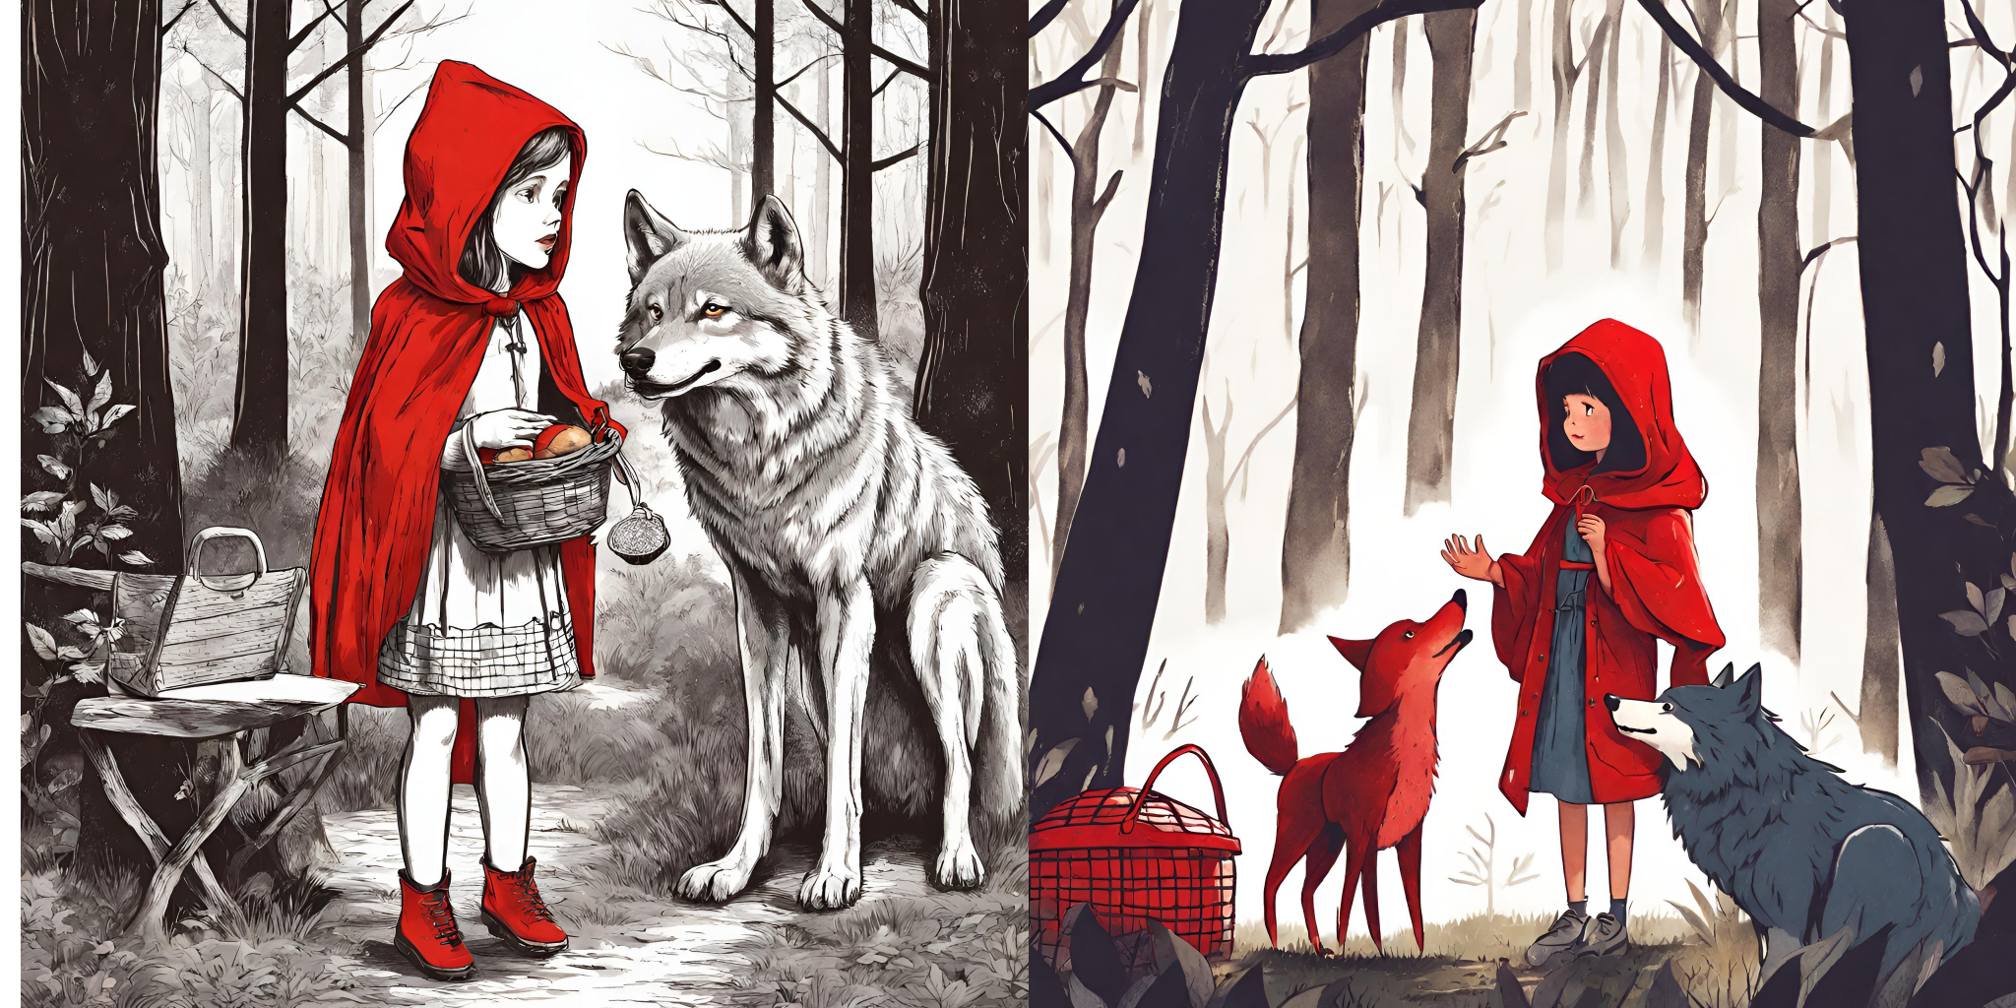
An image is worth a thousand words
1- Look at the three different images.
2- Read the texts used to create the images in Canva.
3- Notice the different elements added.
There is a little girl with a red hood.
She has a picnic basket in her hands.
She is talking with a wolf in the forest.
There is a little girl with a red hood.
She has a picnic basket in her hands.
She is talking with a wolf in the forest.
The little girl is scared.
There is a little girl with a red hood.
She has a picnic basket in her hands.
She is talking with a wolf in the forest.
The little girl is scared.
There is a wooden house behind.
1- You will create an image to illustrate the story you have read.
2- Write different sentences that describe the story.
_____________________________________________________________ _____________________________________________________________ _____________________________________________________________ _____________________________________________________________ _____________________________________________________________

