Slide 1


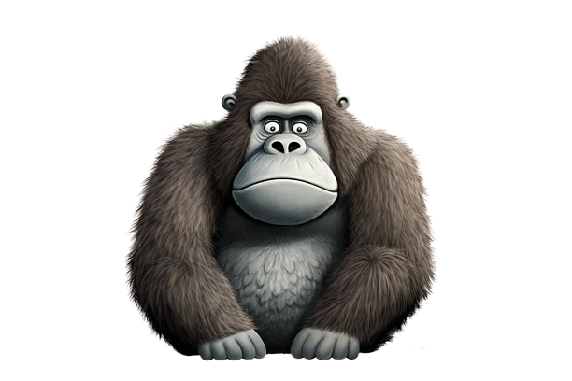

Gorillas are
Look at the model on the left.
Draw and write your ideas for your logo.
awesome
fellas
Text 1: ________________________
Text 2: ________________________
Image 1: _______________________
Image 2: _______________________
Image 3: _______________________
Text 1: Gorillas are
Text 2: awesome fellas
Image 1: Gorilla (physical description)
Image 2: Banana (food)
Image 3: Tropical leaf (habitat)

