Slide 1
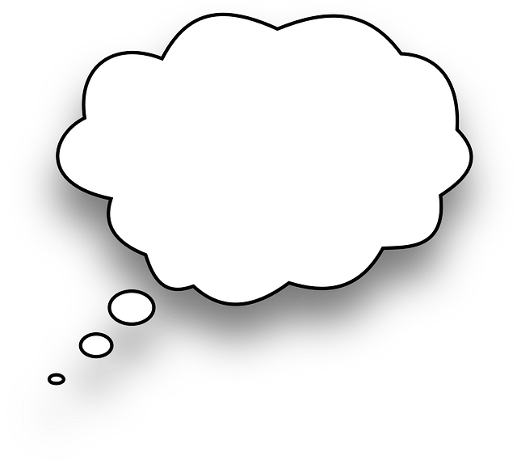
Would you rather have a blue tongue or apply sunscreen on your tongue?
Image from Pixabay

