Slide 1


Inquiry Process
Search
* We invite you to make a copy of this document and modify it according to your needs. (File → Create a copy).

Slide 2


Steps of the Inquiry Process | Class Resources
I search various sources of information.
I determine which source is the most pertinent.
I write my research keywords in a search engine, a library catalogue or a database (using, if necessary, Boolean operators or advanced search parameters).
I reformulate if needed.
I keep traces of the sources and documents that seem most pertinent.
I use different modes of research (facets).
I use bibliographies to focus my research.
LEARN Quebec Resources
Information gathering
Selecting Relevant Information
Where can I find information?
Sandra Laine, inspired by the following charts produced by Rachel DeRoy-Ringuette and the Comité des compétences informationnelles en bibliothèque scolaire. Resource created for the online training: Developing your Information Literacy Competencies on Campus RÉCIT

Slide 3








When and how to use digital tools? | Suggested Digital Tools
I use a different search engines.
I use different catalogues and databases.
Search for extensive sources of information using my predetermined keywords.
Refine and expand my research:
  using the advanced search;
  using Boolean operators and search modes.
Google
Qwant
Bing
Ecosia
Where can I find information?
BAnQ
Biblius.ca
NFB
Sandra Laine, inspired by the following charts produced by Rachel DeRoy-Ringuette and the Comité des compétences informationnelles en bibliothèque scolaire. Resource created for the online training: Developing your Information Literacy Competencies on Campus RÉCIT

Slide 4




When and how to use digital tools? | Suggested Digital Tools
I use different social media platforms.
I question experts.
Facebook
Twitter
Instagram
Tumblr
Where can I find information?
Sandra Laine, inspired by the following charts produced by Rachel DeRoy-Ringuette and the Comité des compétences informationnelles en bibliothèque scolaire. Resource created for the online training: Developing your Information Literacy Competencies on Campus RÉCIT

Slide 5



When and how to use digital tools? | Suggested Digital Tools
I use a content aggregator.
Stay informed on the latest news or publications on a website.
Where can I find information?
Netvibes
Flipboard
Feedly
Sandra Laine, inspired by the following charts produced by Rachel DeRoy-Ringuette and the Comité des compétences informationnelles en bibliothèque scolaire. Resource created for the online training: Developing your Information Literacy Competencies on Campus RÉCIT
z

Slide 6
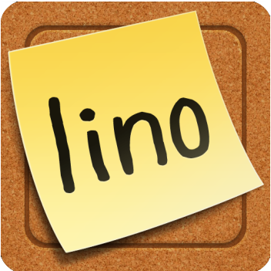
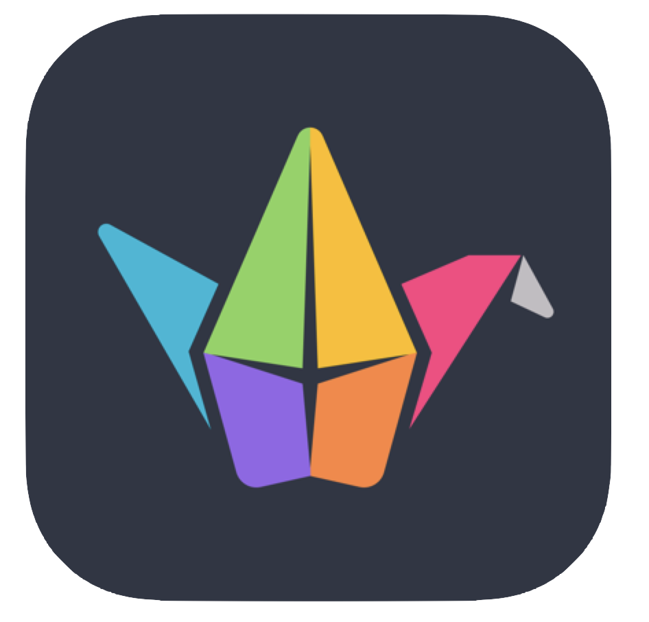

When and how to use digital tools? | Suggested Digital Tools
I use online notice boards.
Keep traces of the information found.
Organize content in different categories or type of resources.
Where can I find information?
Linoit
Padlet
Wakelet
Sandra Laine, inspired by the following charts produced by Rachel DeRoy-Ringuette and the Comité des compétences informationnelles en bibliothèque scolaire. Resource created for the online training: Developing your Information Literacy Competencies on Campus RÉCIT

